Slide 1
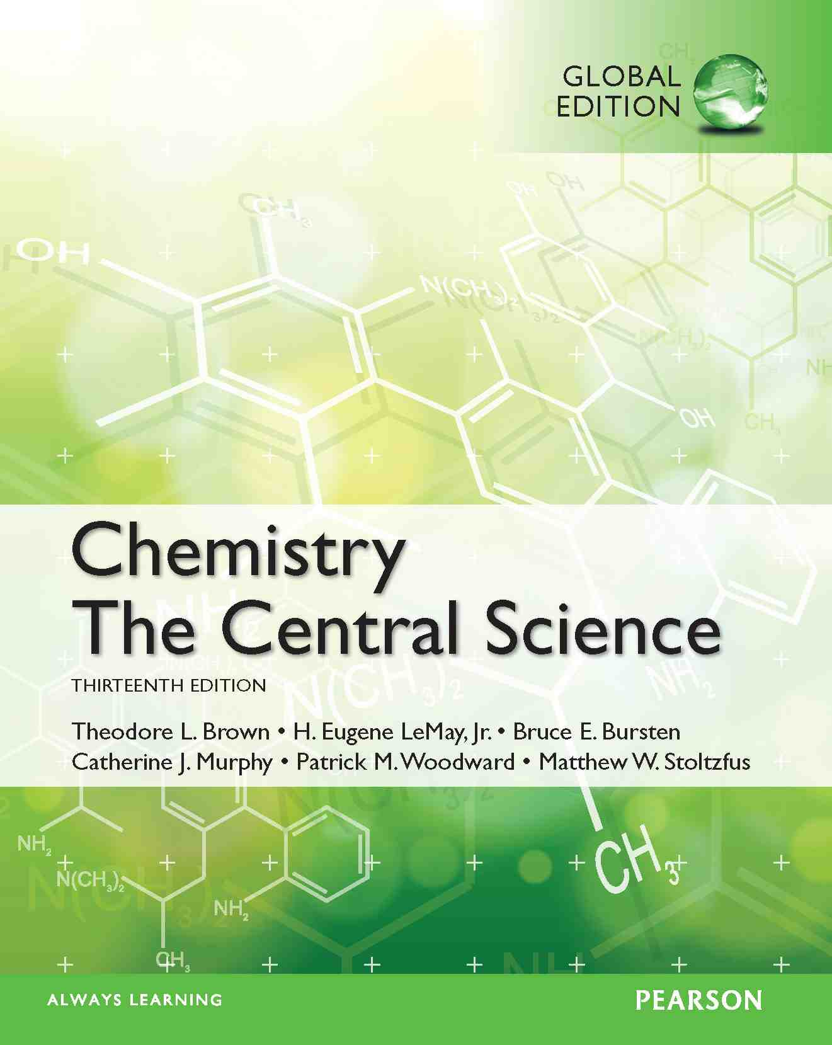
Lecture Presentation
Chapter 15 Chemical Equilibrium
James F. Kirby
Quinnipiac University
Hamden, CT

Slide 2
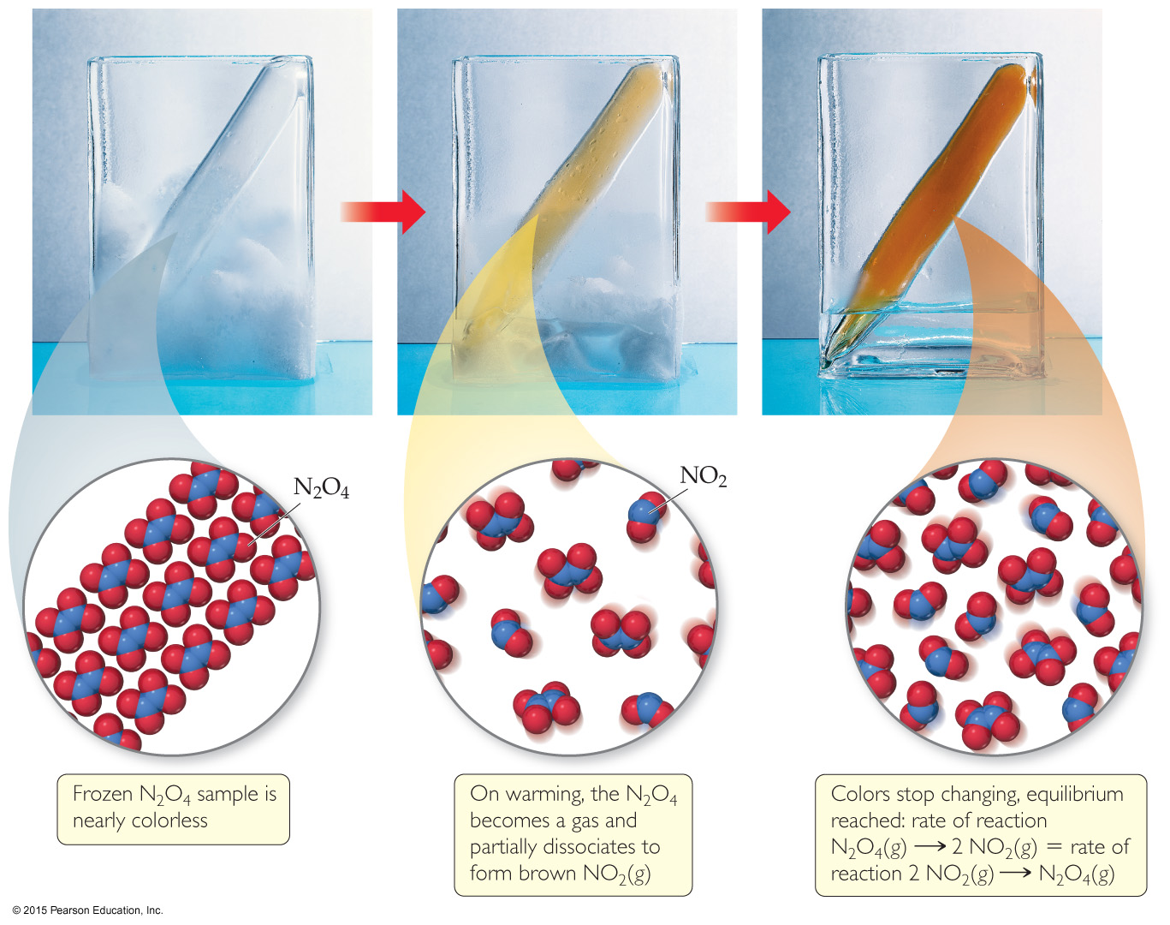
The Concept of Equilibrium
Chemical equilibrium occurs when a reaction and its reverse reaction proceed at the same rate. In the figure above, equilibrium is finally reached in the third picture.

Slide 3
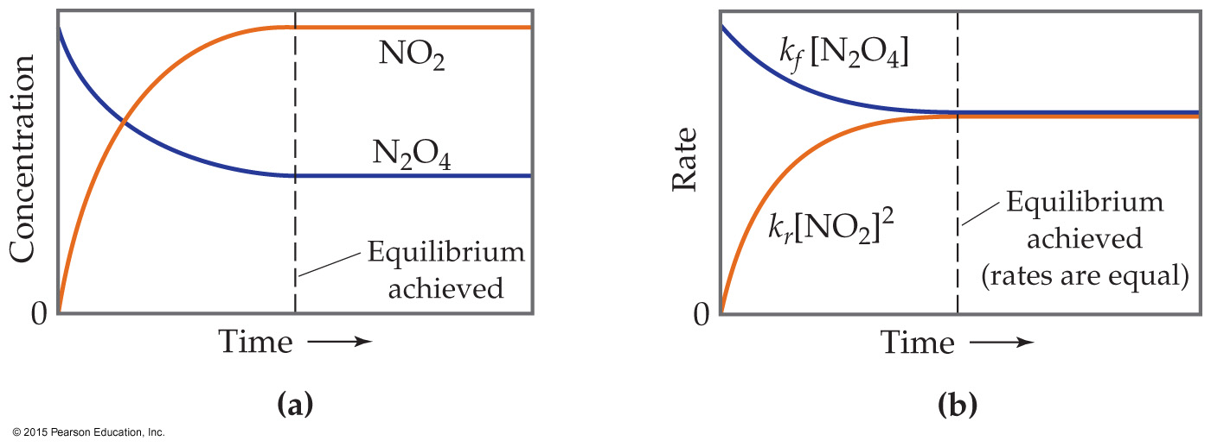
The Concept of Equilibrium
As a system approaches equilibrium, both the forward and reverse reactions are occurring.
At equilibrium, the forward and reverse reactions are proceeding at the same rate – DYNAMIC！
Once equilibrium is achieved, the amount of each reactant and product remains constant.

Slide 4
Writing the Equation for an Equilibrium Reaction
Since, in a system at equilibrium, both the forward and reverse reactions are being carried out, we write its equation with a double arrow:
N₂O₄(g) ⇌ 2 NO₂(g)

Slide 5
Comparing Rates
For the forward reaction N₂O₄(g) → 2 NO₂(g)
The rate law is Rate = k_{f} [N₂O₄]
For the reverse reaction 2 NO₂(g) → N₂O₄(g)
The rate law is Rate = k_{r} [NO₂]²

Slide 6
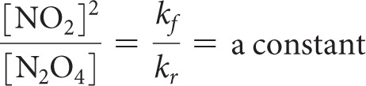
The Meaning of Equilibrium
Therefore, at equilibrium
Rate_{f} = Rate_{r}
k_{f}[N₂O₄] = k_{r}[NO₂]²
Rewriting this, it becomes the expression for the equilibrium constant, K_{eq}.

Slide 7
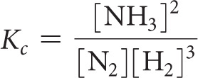
Another Equilibrium— The Haber Process
Consider the Haber Process, which is the industrial preparation of ammonia:
N₂(g) + 3 H₂(g) ⇌ 2 NH₃(g)
The equilibrium constant depends on stoichiometry:

Slide 8
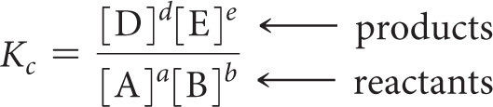
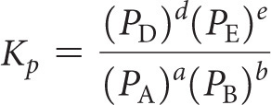
The Equilibrium Constant
Consider the generalized reaction
a A + b B ⇌ d D + e E
The equilibrium expression for this reaction would be
Also, since pressure is proportional to concentration for gases in a closed system, the equilibrium expression can also be written

Slide 9

More with Gases and Equilibrium
We can compare the equilibrium constant based on concentration to the one based on pressure.
For gases, PV = nRT (the Ideal Gas Law).
Rearranging, P = (n/V)RT; (n/V) is [ ].
The result is
where

Slide 10
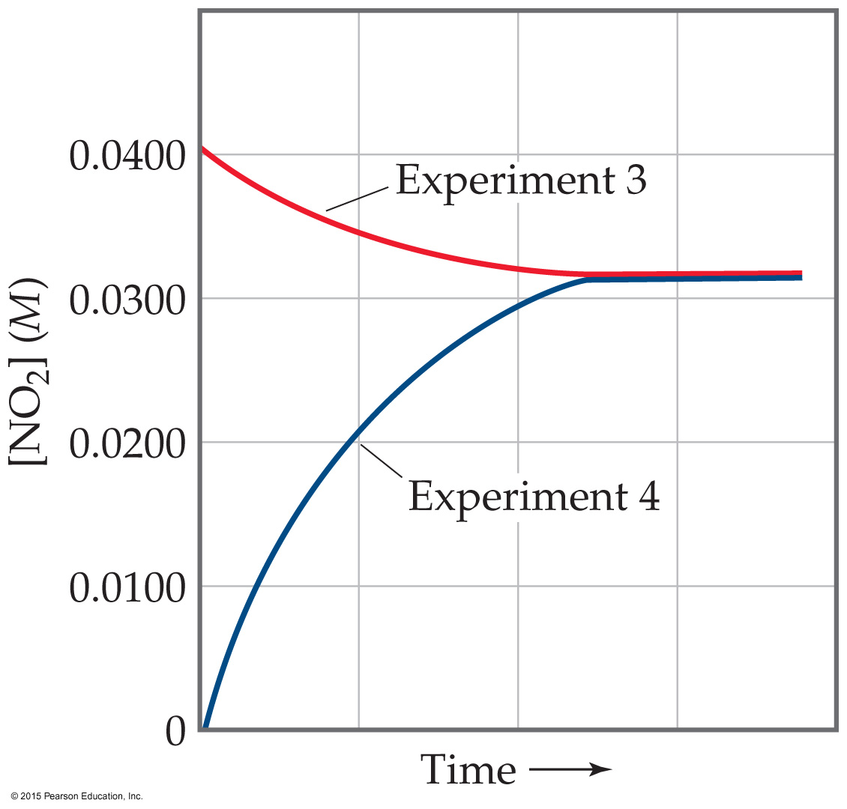
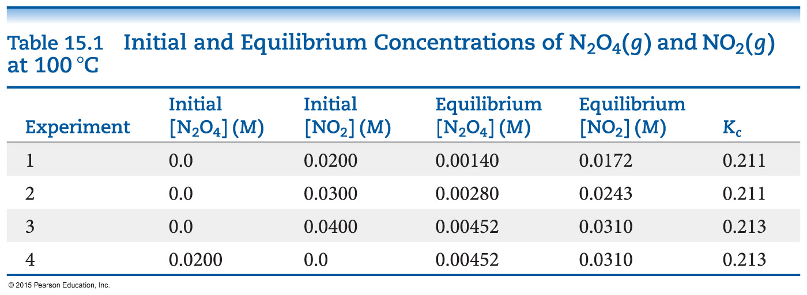
Equilibrium Can Be Reached from Either Direction
As you can see, the ratio of [NO₂]² to [N₂O₄] remains constant at this temperature no matter what the initial concentrations of NO₂ and N₂O₄ are.

Slide 11
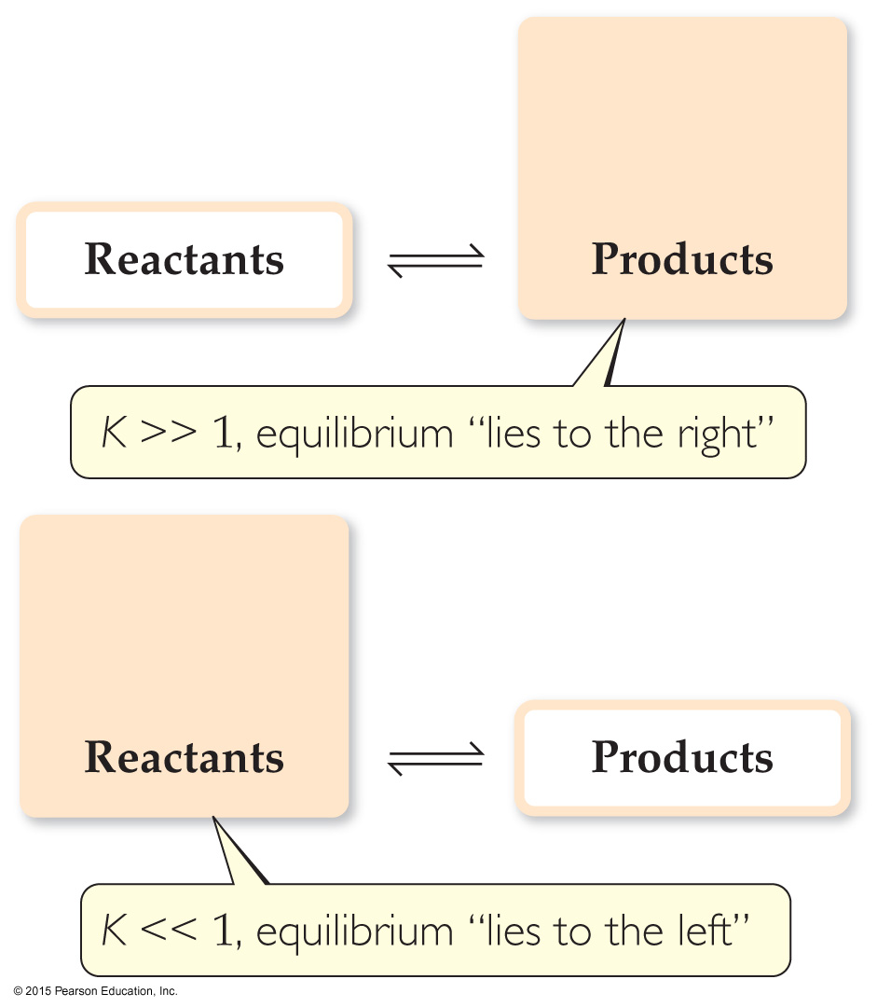
Magnitude of K
If K>>1, the reaction favors products; products predominate at equilibrium.
If K<<1, the reaction favors reactants; reactants predominate at equilibrium.

Slide 12
The Direction of the Chemical Equation and K
The equilibrium constant of a reaction in the reverse reaction is the reciprocal of the equilibrium constant of the forward reaction:
[NO₂]²
[N₂O₄]
N₂O₄(g)
2 NO₂(g)
K_{c} = = 0.212 at 100 °C
⇌
2 NO₂(g)
⇌
N₂O₄(g)
[N₂O₄]
[NO₂]²
K_{c} = = 4.72 at 100 °C

Slide 13
Stoichiometry and Equilibrium Constants
To find the new equilibrium constant of a reaction when the equation has been multiplied by a number, simply raise the original equilibrium constant to that power. Here, the stoichiometry is doubled; the constant is the squared!
[NO₂]²
[N₂O₄]
N₂O₄(g)
⇌
2 NO₂(g)
K_{c} = = 0.212 at 100 °C
[NO₂]⁴
[N₂O₄]²
2 N₂O₄(g)
⇌
4 NO₂(g)
K_{c} = = (0.212)² at 100 °C

Slide 14
2 N₂O₄(g)
⇌
4 NO₂(g) K_{c}’
N₂O₄(g)
⇌
2 NO₂(g) K_{c}
N₂O₄(g)
⇌
2 NO₂(g) K_{c}
K_{c}’ = K_{c} x K_{c}

Slide 15
Consecutive Equilibria
When two consecutive equilibria occur, the equations can be added to give a single equilibrium.
The equilibrium constant of the new reaction is the product of the two constants:
K₃ = K₁ × K₂
Example
2 NOBr ⇌ 2 NO + Br₂ K₁ = 0.014
Br₂ + Cl₂ ⇌ 2 BrCl K₂ = 7.2
2 NOBr + Cl₂ ⇌ 2 NO + 2 BrCl
K₃ = K₁ × K₂ = 0.014 × 7.2 = 0.10

Slide 16
Homogeneous vs. Heterogeneous
Homogeneous equilibria occur when all reactants and products are in the same phase.
Heterogeneous equilibria occur when something in the equilibrium is in a different phase.
The value used for the concentration of a pure substance is always 1.

Slide 17
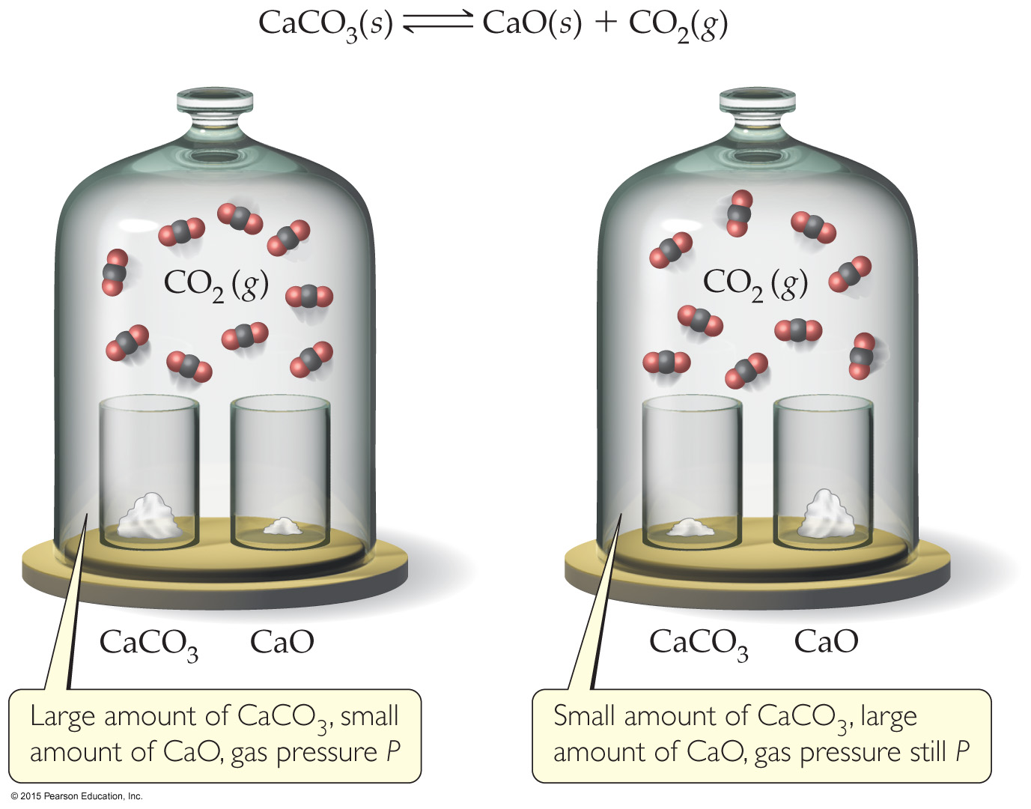
The Decomposition of CaCO₃— A Heterogeneous Equilibrium
The equation for the reaction is
CaCO₃(s) ⇌ CaO(s) + CO₂(g)
This results in
K_{c} = [CO₂]
and
K_{p} = P_{CO2}

Slide 18
Deducing Equilibrium Concentrations
ICE approach
I - Initial Concentration(s)
C - Change in Concentration(s) when equilibrium is reached in comparison to the initial concentration(s)
E – Concentrations at Equilibrium

Slide 19
An Example
A closed system initially containing 1.000 × 10^{–3} M H₂ and 2.000×10^{–3} M I₂ at 448ºC is allowed to reach equilibrium. Analysis of the equilibrium mixture shows that the concentration of HI is 1.87 × 10^{–3} M. Calculate K_{c} at 448ºC for the reaction taking place, which is
H₂(g) + I₂(g) ⇌ 2 HI(g)

Slide 20
What Do We Know?
 | [H₂], M | [I₂], M | [HI], M
Initial Concentration | 1.000 × 10^{–3} | 2.000 × 10^{–3} | 0
Change in Concentration | - (1/2) 1.87 × 10^{–3} | - (1/2) 1.87 × 10^{–3} | + 1.87 × 10^{–3}
Concentration at Equilibrium | (1.000 – 0.935) × 10^{–3} = 0.065 × 10^{–3} | (2.000 – 0.935) × 10^{–3} = 1.065 × 10^{–3} | 1.87 × 10^{–3}

Slide 21
And, therefore, the equilibrium constant…
[HI]²
[H₂] [I₂]
K_{c} =
(1.87 × 10^{–3})²
(6.5 × 10^{–5})(1.065 × 10^{–3})
=
= 51

Slide 22
Calculating Equilibrium Concentrations (using the same ICE approach)
If you know the equilibrium constant, you can find equilibrium concentrations from initial concentrations and changes (based on stoichiometry).

Slide 23
A 1.000 L flask is filled with 1.000 mol of H₂(g) and 2.000 mol of I₂(g) at 448 °C. Given a K_{c} of 50.5 at 448 °C, what are the equilibrium concentrations of H₂, I₂, and HI?
H₂(g) + I₂(g) ⇌ 2 HI(g)
initial concentration (M) | 1.000 | 2.000 | 0
change in concentration (M) | –x | –x | +2x
equilibrium concentration (M) | 1.000 – x | 2.000 – x | 2x

Slide 24

Set up the equilibrium constant expression, filling in equilibrium concentrations from the table.
Solving for x is done using the quadratic formula, resulting in x = 2.323 or 0.935.

Slide 25
Since x must be subtracted from 1.000 M, 2.323 makes no physical sense. (It results in a negative concentration!) The value must be 0.935.
So
[H₂]_{eq} = 1.000 – 0.935 = 0.065 M
[I₂]_{eq} = 2.000 – 0.935 = 1.065 M
[HI]_{eq} = 2(0.935) = 1.87 M

Slide 26
Is a Mixture in Equilibrium? Which Way Does the Reaction Go?
To answer these questions, we calculate the reaction quotient, Q.
Q looks like the equilibrium constant, K, but the values used to calculate it are the current conditions, not necessarily those for equilibrium.
To calculate Q, one substitutes the initial concentrations of reactants and products into the equilibrium expression.

Slide 27
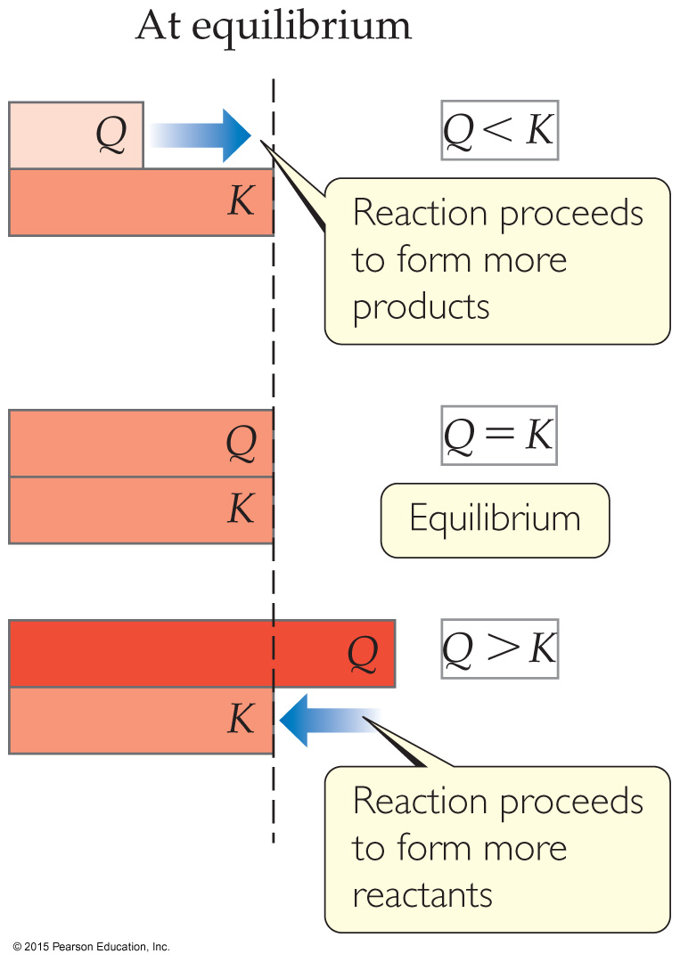
Comparing Q and K
Nature wants Q = K.
If Q < K, nature will make the reaction proceed to products.
If Q = K, the reaction is in equilibrium.
If Q > K, nature will make the reaction proceed to reactants.

Slide 28
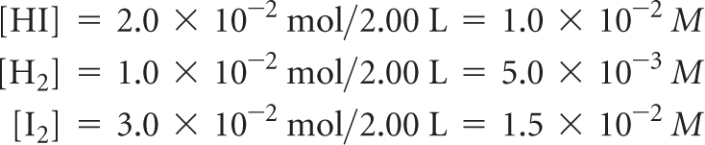

Exercise Predicting the Direction of Approach to Equilibrium
At 448 °C the equilibrium constant K_{c} for the reaction
is 50.5. Predict in which direction the reaction proceeds to reach equilibrium if we start with 2.0 × 10⁻² mol of HI, 1.0 × 10⁻² mol of H₂, and 3.0 × 10⁻² of I₂ in a 2.00-L container.
Solution
The current concentrations are
The reaction quotient is therefore
Because Q_{c} < K_{c}, the concentration of HI must increase and the concentrations of H₂ and I₂ must decrease to reach equilibrium; the reaction as written proceeds left to right to attain equilibrium.

Slide 29
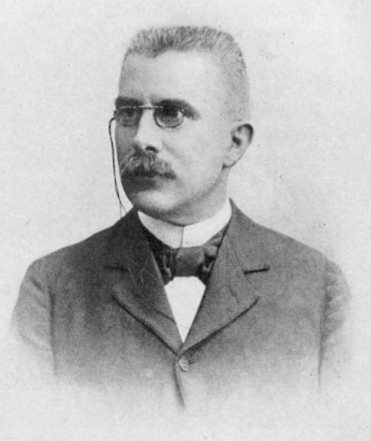
Le Châtelier’s Principle
Henri-Louis Le Châtelier (1850−1936)

Slide 30
LeChâtelier’s Principle
“If a system at equilibrium is disturbed by a change in temperature, pressure （volume）, or the concentration of one of the components, the system will shift its equilibrium position so as to counteract （offset） the effect of the disturbance.”

Slide 31
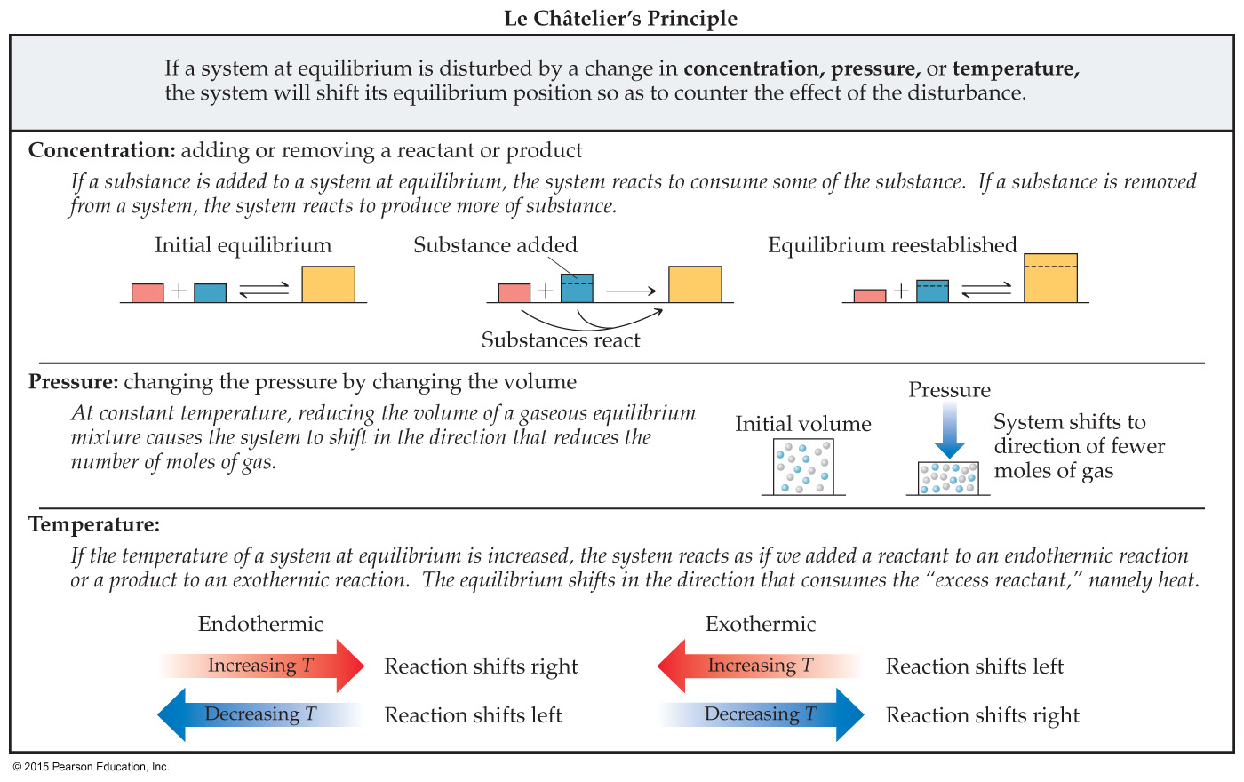
Using LeChâtelier’s Principle qualitatively to predict shifts in equilibrium based on changes in conditions.

Slide 32
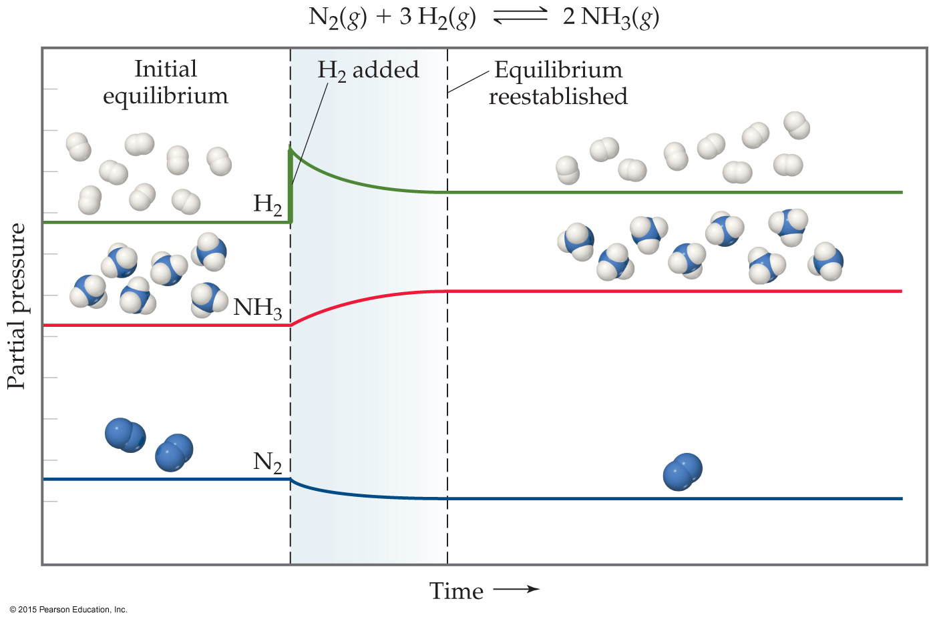
Change in Reactant or Product Concentration
If the system is in equilibrium
adding a reaction component will result in some of it being used up.
removing a reaction component will result in some if it being produced.

Slide 33
Using LeChâtelier’s Principle qualitatively to predict shifts in equilibrium based on changes in conditions.

Slide 34
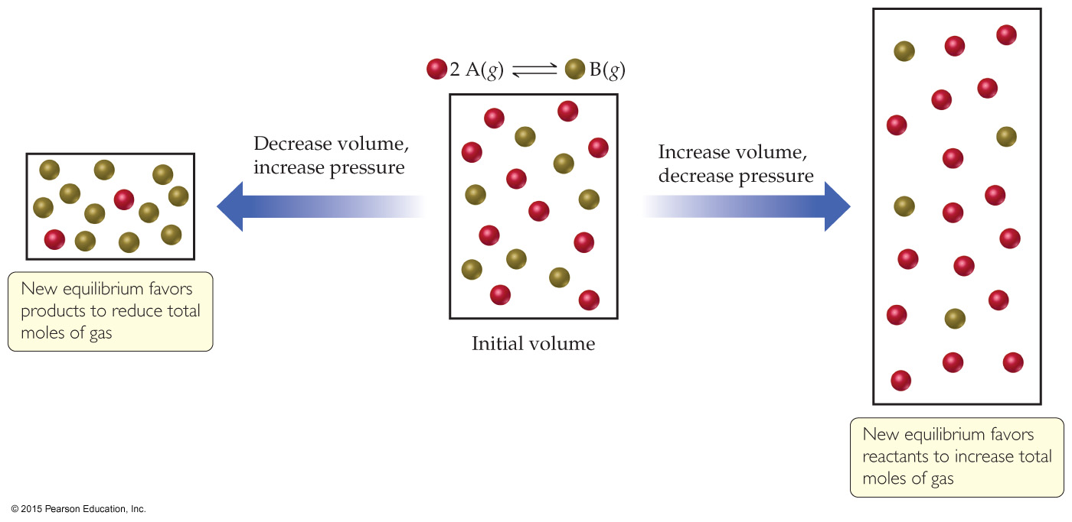
Change in Volume or Pressure
When gases are involved in an equilibrium, a change in pressure or volume will affect equilibrium:
Higher volume or lower pressure favors the side of the equation with more moles (and vice-versa).

Slide 35
Using LeChâtelier’s Principle qualitatively to predict shifts in equilibrium based on changes in conditions.

Slide 36
Change in Temperature
Is the reaction endothermic or exothermic as written? That matters!
Exothermic: Heat acts like a product; adding heat drives a reaction toward reactants.
Reactants → Products + heat
Endothermic: Heats acts like a reactant; adding heat drives a reaction toward products.
Reactants + heat → Products

Slide 37
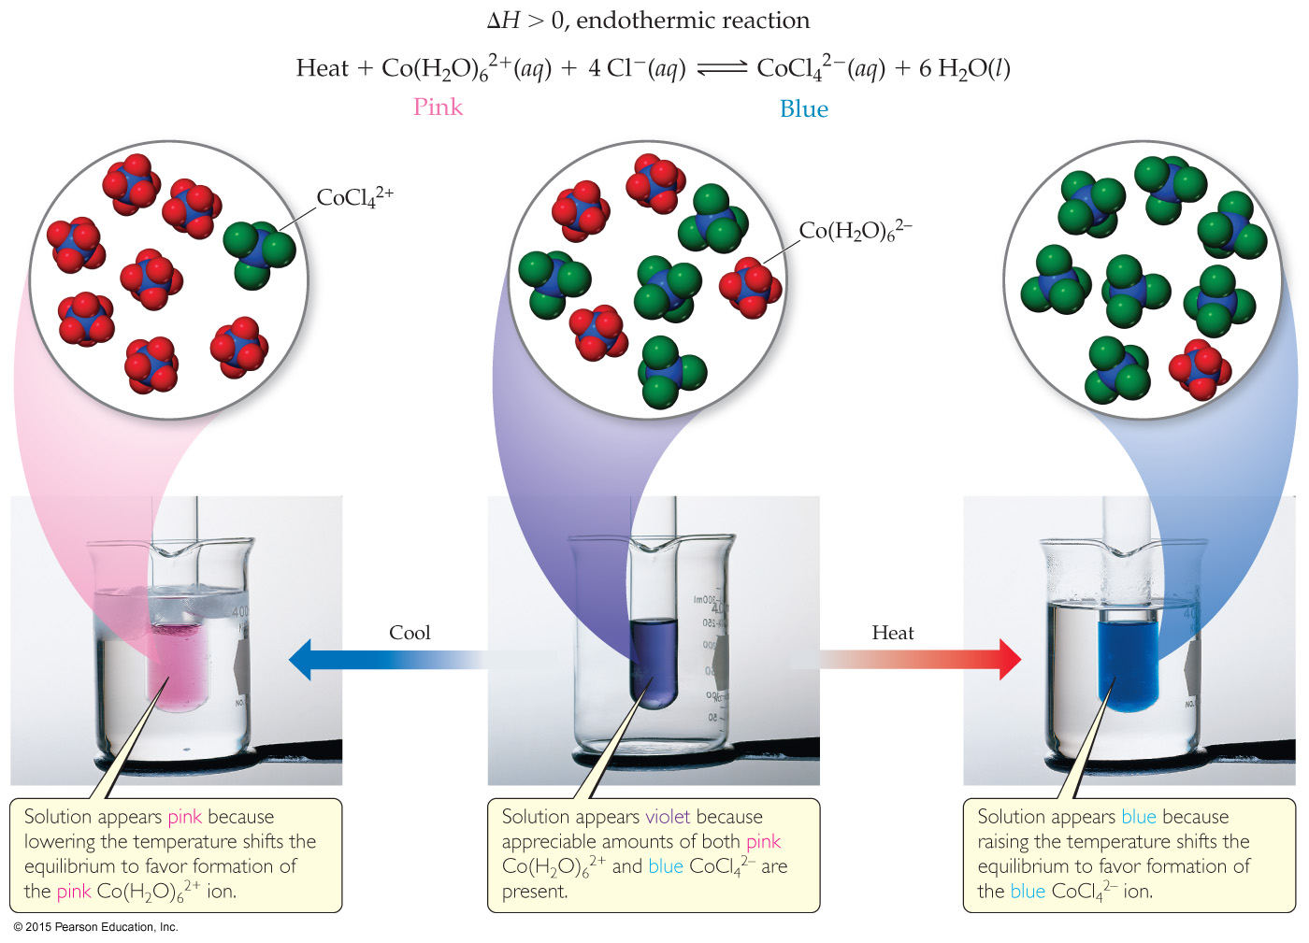
An Endothermic Equilibrium

Slide 38
An Exothermic Equilibrium
The Haber Process for producing ammonia from the elements is exothermic.
One would think that cooling down the reactants would result in more product (larger K_{eq}) but slower reaction (smaller k).
The activation energy for this reaction is high!
This is the one instance where a system in equilibrium can be affected by a catalyst!

Slide 39
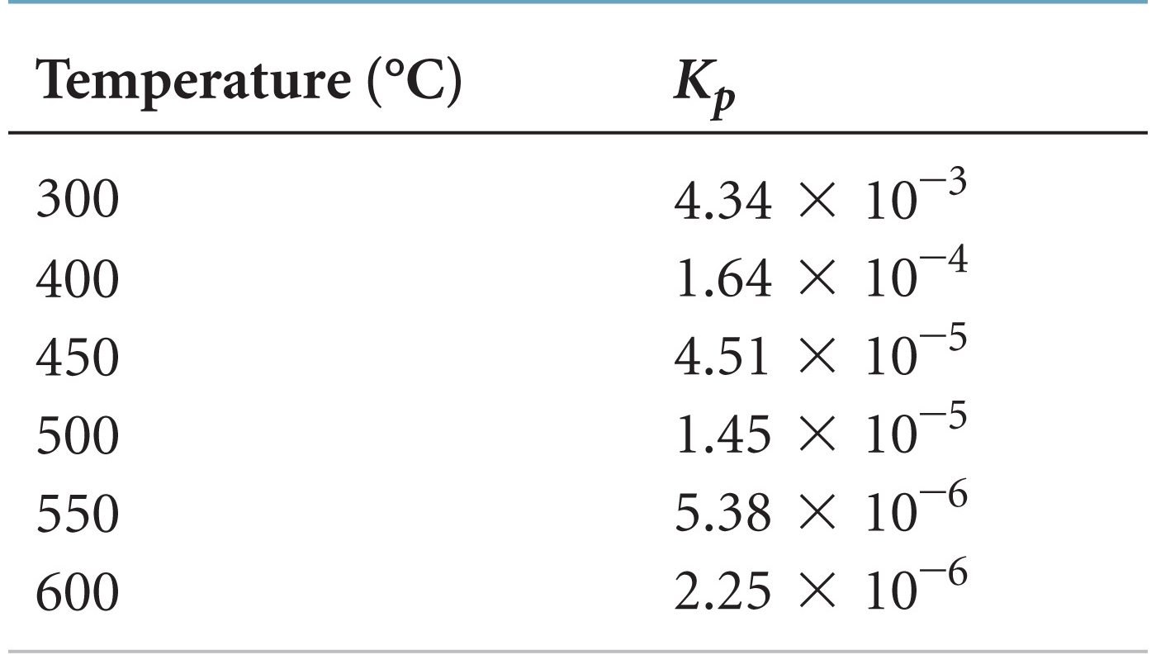
Changes in Temperature
N₂(g) + 3 H₂(g) → 2 NH₃(g) ΔH = –92 kJ/mol

Slide 40
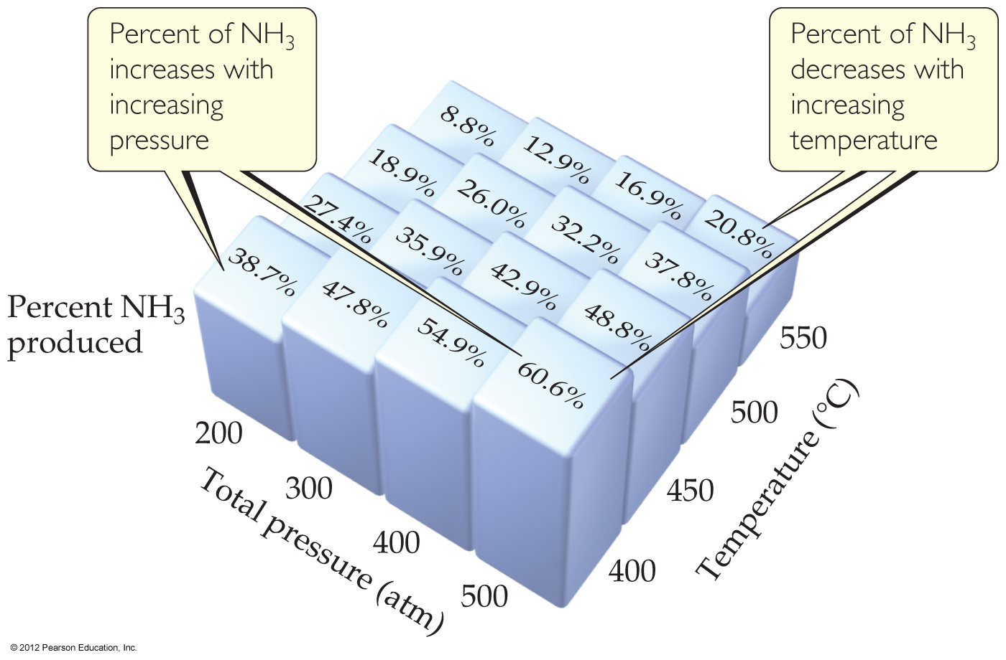
The Haber Process
N₂(g) + 3 H₂(g) → 2 NH₃(g) ΔH = –92 kJ/mol
The transformation of nitrogen and hydrogen into ammonia (NH₃) is of tremendous significance in agriculture, where ammonia-based fertilizers are of utmost importance.

Slide 41
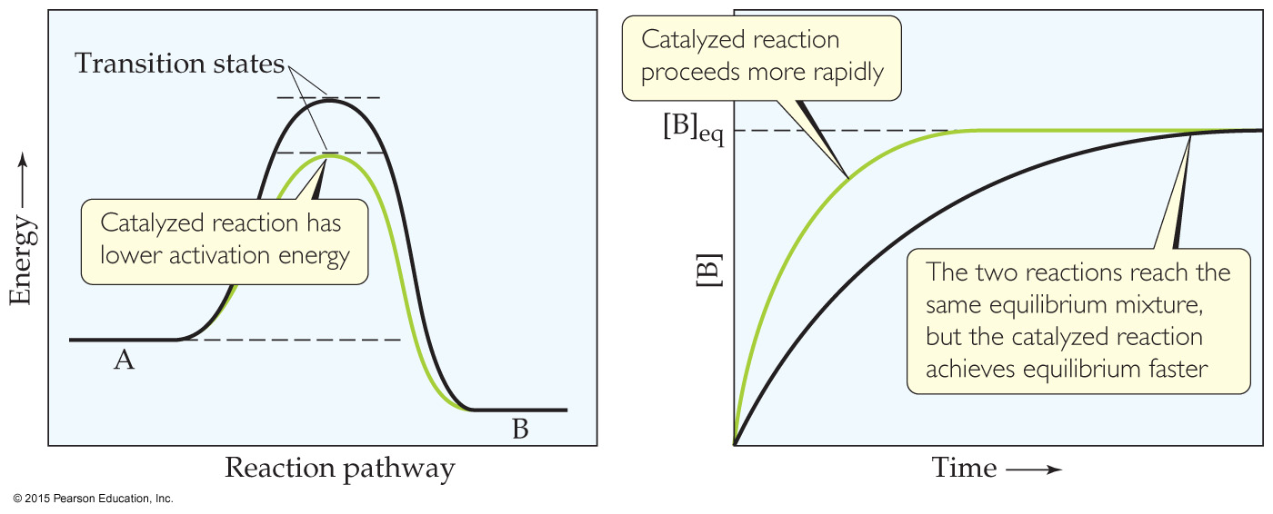
Catalysts
Catalysts increase the rate of both the forward and reverse reactions.
Equilibrium is achieved faster, but the equilibrium composition remains unaltered.
Activation energy is lowered, allowing equilibrium to be established at lower temperatures.

Slide 42
Le Châtelier’s Principle
System | Change | Result
CO₂ + H₂ → H₂O(g) + CO | A drying agent is added to absorb H₂O
H₂(g) + I₂(g) → 2HI(g) | Some nitrogen gas is added
NaCl(s) + H₂SO₄(l) → Na₂SO₄(s) + HCl(g) | Reaction is carried out in an open container
H₂O(l) → H₂O(g) | Water evaporates from an open container
HCN(aq) → H⁺(aq) + CN–(aq) | The solution is diluted
AgCl(s) → Ag⁺(aq) + Cl–(aq) | Some NaCl is added to the solution
N₂ + 3 H₂ → 2 NH₃ | A catalyst is added to speed up this reaction
Shift to the right. Continuous removal of a product will force any reaction to the right
No change; N₂ is not a component of this reaction system.
Because HCl is a gas that can escape from the system, the reaction is forced to the right. This is the basis for the commercial production of hydrochloric acid.
Continuous removal of water vapor forces the reaction to the right, so equilibrium is never achieved.
Shift to right; the product [H⁺][CN—] diminishes more rapidly than does [HCN].
Shift to left due to increase in Cl– concentration. This is known as the common ion effect on solubility.
No change. Catalysts affect only the rate of a reaction; they have no effect at all on the composition of the equilibrium state.

Slide 43
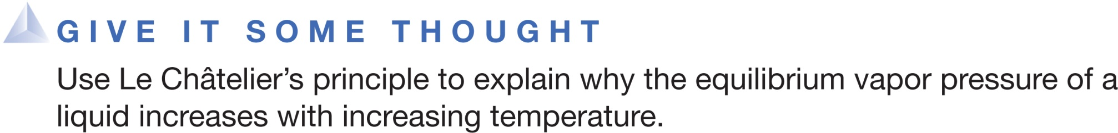

Evaporation is an exothermic process and an increasing temperature shifts the equilibrium to the right and increases the equilibrium vapor pressure.
Evaporation is an endothermic process and an increasing temperature shifts the equilibrium to the right and increases the equilibrium vapor pressure.
Evaporation is an exothermic process and an increasing temperature shifts the equilibrium to the left and increases the equilibrium vapor pressure.
Evaporation is an endothermic process and an increasing temperature shifts the equilibrium to the left and increases the equilibrium vapor pressure.

Slide 44

At equilibrium, the rate of the forward reaction is _______ the rate of the reverse reaction.
equal to
slower than
faster than
d. the reverse of
Notes:
Answer: a

Slide 45
The reaction quotient Q is usually represented by
[reactants] / [products].
[products] / [reactants].
[reactants]  [products].
d. [reactants] + [products].
Notes:
Answer: b

Slide 46
If the value of the equilibrium constant is large, then _______ will mostly be present at equilibrium.
reactants
products
catalysts
d. shrapnel
Notes:
Answer: b

Slide 47
If the value of the equilibrium constant is small, then _______ will mostly be present at equilibrium.
reactants
products
catalysts
d. shrapnel
Notes:
Answer: a

Slide 48
Q = the reaction quotient K = the equilibrium constant At equilibrium, which is true?
Q > K
Q < K
Q = K
d. Q² = K
Notes:
Answer: c

Slide 49
Equilibrium constants typically have units of
M.
M².
M^{1–}.
d. None of the above
Notes:
Answer: d

Slide 50
Reaction quotients for heterogeneous equilibria do not include concentrations of
pure liquids.
pure solids.
Both of the above
d. Neither of the above
Notes:
Answer: c

Slide 51
HA ←→ H⁺ + A– [HA] = 1.65  10^{–2} M and [H⁺] = [A–] = 5.44  10^{–4} M at equilibrium. K_{c} = _______.
1.79  10^{–2}
1.79  10^{–3}
1.79  10^{–4}
d. 1.79  10^{–5}
Notes:
Answer: d

Slide 52
K_{P} = K_{C} when
the reaction is at equilibrium.
the reaction is exothermic.
all of the gases present are at the same pressure.
d. the number of moles of gas on both sides of the balanced equation is the same.
Notes:
Answer: d

Slide 53
CO₂ + H₂ ←→ CO + H₂O If all species are gases and H₂ is added, the concentration of CO at equilibrium will
increase.
decrease.
remain unchanged.
d. disappear.
Notes:
Answer: a

Slide 54
CO₂ + H₂ ←→ CO + H₂O If all species are gases and H₂O is added, the equilibrium concentration of CO
will increase.
will decrease.
will remain unchanged.
d. will disappear.
Notes:
Answer: b

Slide 55
CO₂ + H₂ ←→ CO + H₂O If all species are gases and CO₂ is removed, the [CO] at equilibrium will
increase.
decrease.
remain unchanged.
d. disappear.
Notes:
Answer: b

Slide 56
CO₂ + H₂ ←→ CO + H₂O Increasing the temperature of this endothermic reaction will _______ [CO] at equilibrium.
increase
decrease
not change
d. eradicate
Notes:
Answer: a

Slide 57
CO₂ + H₂ ←→ CO + H₂O If all species are gases and the container is compressed, the amount of CO will
increase.
decrease.
remain unchanged.
d. vanish.
Notes:
Answer: c

Slide 58
CO₂ + H₂ ←→ CO + H₂O Adding a catalyst to this reaction will cause the [CO] at equilibrium to
increase.
decrease.
remain unchanged.
d. cease to exist.
Notes:
Answer: c

